Slide 1
DATA MINING BASICS

Slide 2
OBJECTIVE:
What is Data Mining – Data Mining Definitions
Data Mining Architecture
Data Mining Applications
Advantages and Disadvantages of Data Mining
Data Mining Processes
Data Mining Techniques

Slide 3
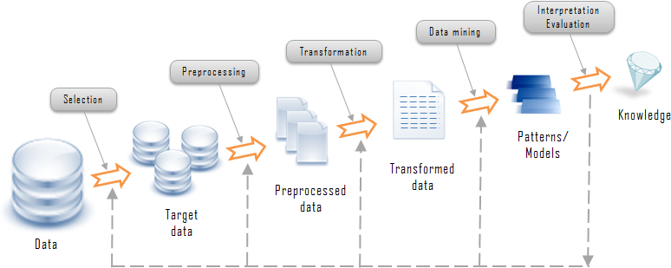
Knowledge Discovery
Knowledge discovery is a process that extracts implicit, potentially useful or previously unknown information from the data. The knowledge discovery process is described as follows:
Knowledge Discovery Process

Slide 4
Let’s examine the knowledge discovery process in the diagram above in details:
Data comes from variety of sources is integrated into a single data store called target data
Data then is pre-processed and transformed into standard format.
The data mining algorithms process the data to the output in form of patterns or rules.
Then those patterns and rules are interpreted to new or useful knowledge or information.
The ultimate goal of knowledge discovery and data mining process is to find the patterns that are hidden among the huge sets of data and interpret them to useful knowledge and information.
As described in process diagram above, data mining is a central part of knowledge discovery process. Let answer the question “what is data mining?” by examining several data mining definitions.

Slide 5
What is Data Mining – Data Mining Definitions
Data mining is a process used by companies to turn raw data into useful information. By using software to look for patterns in large batches of data, businesses can learn more about their customers and develop more effective marketing strategies as well as increase sales and decrease costs.
Data mining is a process that analyzes the large amount of data to find the new and hidden information that improves business efficiency.
Various industries have been adopt data mining to their mission-critical business processes to gain competitive advantages and help business grows.
Data mining is the practice of automatically searching large stores of data to discover patterns and trends that go beyond simple analysis.

Slide 6
Data mining depends on effective data collection and warehousing as well as computer processing.
Data mining uses sophisticated mathematical algorithms to segment the data and evaluate the probability of future events.
Data mining is also known as Knowledge Discovery in Data (KDD).
The key properties of data mining are:
Automatic discovery of patterns
Prediction of likely outcomes
Creation of actionable information
Focus on large data sets and databases
Data mining can answer questions that cannot be addressed through simple query and reporting techniques.

Slide 7
Data Mining Architecture
There are four possible architectures of a data mining system as follows:
No-coupling
In this architecture,
A data mining system does not utilize any functionality of a database or data warehouse system.
A no-coupling data mining system retrieves data from a particular data sources such as file system, processes data using major data mining algorithms and stores results into file system.
The no-coupling data mining architecture does not take any advantages of database or data warehouse that is already very efficient in organizing, storing, accessing and retrieving data.
The no-coupling architecture is considered a poor architecture for data mining system however it is used for simple data mining processes.

Slide 8
2) Loose Coupling
In this architecture,
A data mining system uses database or data warehouse for data retrieval.
In loose coupling data mining architecture, data mining system retrieves data from database or data warehouse, processes data using data mining algorithms and stores the result in those systems.
This architecture is mainly for memory-based data mining system that does not require high scalability and high performance.

Slide 9
3) Semi-tight Coupling
In this architecture,
Linking to database or data warehouse system.
Uses several features of database or data warehouse systems to perform some data mining tasks including sorting, indexing, aggregation…etc.
Some intermediate result can be stored in database or data warehouse system for better performance.

Slide 10
4) Tight Coupling
In this architecture,
Database or data warehouse is treated as an information retrieval component of data mining system using integration.
All the features of database or data warehouse are used to perform data mining tasks.
Provides system scalability, high performance and integrated information.

Slide 11
Data Mining Applications
Data Mining Applications in Sales/Marketing
Data mining enables the businesses to understand the patterns hidden inside past purchase transactions, thus helping in plan and launch new marketing campaigns in prompt and cost effective way.
Data mining is used for market basket analysis to provides insight information on what product combinations were purchased, when they were bought and in what sequence by customers. This information helps businesses to promote their most profitable products to maximize the profit. In addition, it encourages customers to purchase related products that they may have been missed or overlooked.
Retails companies uses data mining to identify customer’s behavior buying patterns.

Slide 12
Data Mining Applications in Banking / Finance
Several data mining techniques such as distributed data mining has been researched, modeled and developed to help credit card fraud detection.
Data mining is used to identify customers loyalty by analyzing the data of customer’s purchasing activities such as the data of frequency of purchase in a period of time, total monetary value of all purchases and when was the last purchase. After analyzing those dimensions, the relative measure is generated for each customer.
To help bank to retain credit card customers, data mining is used. By analyzing the past data, data mining can help banks to predict customers that likely to change their credit card affiliation so they can plan and launch different special offers to retain those customers.
Credit card spending by customer groups can be identified by using data mining.
The hidden correlation’s between different financial indicators can be discovered by using data mining.
From historical market data, data mining enable to identify stock trading rules.

Slide 13
Data Mining Applications in Health Care and Insurance
The growth of the insurance industry is entirely depends on the ability of converting data into the knowledge about customers, competitors and its markets.
The data mining applications in insurance industry are listed below:
Data mining is applied in claims analysis such as identifying which medical procedures are claimed together.
Data mining enables to forecasts which customers will potentially purchase new policies.
Data mining allows insurance companies to detect risky customers’ behavior patterns.

Slide 14
Data Mining Applications in Medicine
Data mining enables to characterize patient activities to see coming office visits.
Data mining help identify the patterns of successful medical therapies for different illnesses.

Slide 15
Advantages and Disadvantages of Data Mining
Data mining is an important part of knowledge discovery process that analyzes large enormous set of data and gives us unknown, hidden and useful information and knowledge.
Data mining has not only applied effectively in business environment but also in other fields such as weather forecast, medicine, transportation, healthcare, insurance, government and etc.
Data mining brings a lot of advantages when using in a specific industry. Besides those advantages, data mining also has its own disadvantages as well such as privacy, security and misuse of information.
We will examine the advantage and disadvantages of data mining in different industries in a greater details.

Slide 16
Advantages of Data Mining
Marketing / Retail
Data mining helps marketing companies to build models based on historical data to predict who will respond to new marketing campaign such as direct mail, online marketing campaign and etc.
Finance / Banking
Data mining gives financial institutions information about loan information and credit reporting. By building a model from previous customer’s data with common characteristics, the bank and financial can estimate what are the good and/or bad loans and its risk level. In addition, data mining can help banks to detect fraudulent credit card transaction to help credit card’s owner prevent their losses.
Manufacturing
By applying data mining in operational engineering data, manufacturers can detect faulty equipment's and determine optimal control parameters.
Governments
Data mining helps government agency by digging and analyzing records of financial transaction to build patterns that can detect money laundering or criminal activity.

Slide 17
Disadvantages of data mining
Privacy Issues
The concerns about the personal privacy have been increasing enormously recently especially when internet is booming with social networks, e-commerce, forums, blogs…. Because of privacy issues, people are afraid of their personal information is collected and used in unethical way that potentially causing them a lot of trouble.
Security issues
Security is a big issue. Businesses owns information about their employee and customers including social security number, birthday, payroll and etc. However how properly this information is taken is still in questions. There have been a lot of cases that hackers were accesses and stole big data of customers from big corporation such as Ford Motor Credit Company, Sony… with so much personal and financial information available, the credit card stolen and identity theft become a big problem.
Misuse of information/inaccurate information
Information collected through data mining intended for marketing or ethical purposes can be misused. This information is exploited by unethical people or business to take benefit of vulnerable people or discriminate against a group of people.

Slide 18
Data Mining Processes
The data mining process must be reliable and repeatable by business people with little knowledge or no data mining background.
In 1990, a cross-industry standard process for data mining (CRISP-DM) first published after going through a lot of workshops, and contributions from over 300 organizations. Let’s examine the cross-industry standard process for data mining in greater details.

Slide 19
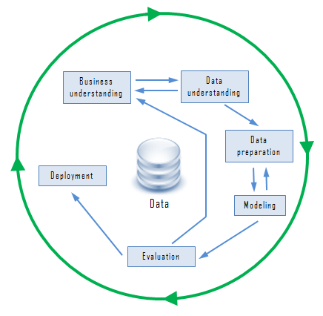
The Cross-Industry Standard Process for Data Mining (CRISP-DM)
Cross-Industry Standard Process for Data Mining (CRISP-DM) consists of six phases intended as a cyclical process as the following figure:
Cross-Industry Standard Process for Data Mining (CRISP-DM)

Slide 20
Business understanding phase
Understand business objectives clearly and make sure to find out what the client really want to achieve.
Assess the current situation by finding about the resources, assumptions, constraints.
Create data mining goals to achieve the business objective and within the current situation.
A good data mining plan has to be established to achieve both business and data mining goals.
Data understanding
Starts with initial data collection that collects data from available sources to get familiar with data.
The “gross” or “surface” properties of acquired data need to be examined carefully and reported.
The data need to be explored by tackling the data mining questions, which can be addressed using querying, reporting and visualization.
The data quality must be examined by answering some important questions such as “Is the acquired data complete?”, “Is there any missing values in the acquired data?”

Slide 21
Data preparation
Once data sources available are identified, they need to be selected, cleaned, constructed and formatted into the desired form.
Modeling
Modeling techniques have to be selected to be used for the prepared dataset.
The test scenario must be generated to validate the models’ quality and validity.
One or more models are created by running the modeling tool on the prepared dataset.
Models need to be assessed carefully involving stakeholders to make sure that created models are meet business initiatives.

Slide 22
Evaluation
The model results must be evaluated in the context of business objectives in the first phase.
New business requirements may be raised due to new patterns has been discovered in the model results or from other factors.
6. Deployment
The information that gain through data mining process needs to be presented in such a way that stakeholders can use it when they want it. Based on the business requirements, the deployment phase could be as simple as creating a report or as complex as a repeatable data mining process across the organization.
The CRISP-DM:
Offers a uniform framework for experience documentation and guidelines.
Can apply in different industry with different type of data.

Slide 23
Data Mining Techniques
There are several major data mining techniques have been developed and used in data mining projects recently including:
Association
Classification
Clustering
Prediction

Slide 24
Association
Association is one of the best known data mining technique.
In association, a pattern is discovered based on a relationship of a particular item on other items in the same transaction.
For example, the association technique is used in market basket analysis to identify what products that customers frequently purchase together.
Based on this data businesses can have corresponding marketing campaign to sell more products to make more profit.

Slide 25
2) Classification
Basically classification is used to classify each item in a set of data into one of predefined set of classes or groups.
Classification method makes use of mathematical techniques such as decision trees, linear programming, neural network and statistics.
The software can learn how to classify the data items into groups.
For example, we can apply classification in application that “given all past records of employees who left the company, predict which current employees are probably to leave in the future.” In this case, we divide the employee’s records into two groups that are “leave” and “stay”. And then we can ask our data mining software to classify the employees into each group.

Slide 26
3) Clustering
Clustering is a data mining technique that makes meaningful or useful cluster of objects that have similar characteristic using automatic technique.
Clustering technique also defines the classes and put objects in them, while in classification objects are assigned into predefined classes.
For example. In a library, books have a wide range of topics available. The challenge is how to keep those books in a way that readers can take several books in a specific topic without hassle. By using clustering technique, we can keep books that have some kind of similarities in one cluster or one shelf and label it with a meaningful name. If readers want to grab books in a topic, he or she would only go to that shelf instead of looking the whole in the library.

Slide 27
4) Prediction
The prediction as it name implied is one of a data mining techniques that discovers relationship between dependent and independent variables.
For instance, prediction analysis technique can be used in sale to predict profit for the future if we consider sale is an independent variable, profit could be a dependent variable.

